Slide 1

Lecture
on
“Advanced Computer Architecture –TCS 704”
by
Akansha Gupta
DEPARTMENT OF COMPUTER SCIENCE AND ENGINEERING
GRAPHIC ERA DEEMED TO BE UNIVERSITY – 248002

Slide 2
Memory Hierarchy

Slide 3
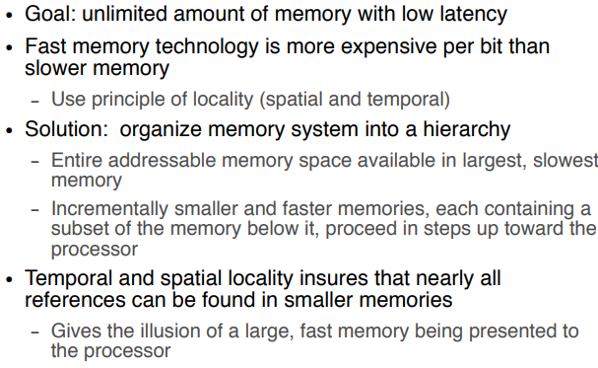
Introduction

Slide 4
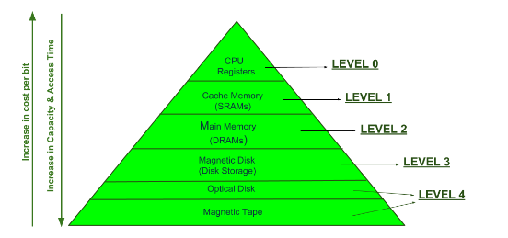
Memory Hierarchy

Slide 5
This Memory Hierarchy Design is divided into 2 main types:
External Memory or Secondary Memory – Comprising of Magnetic Disk, Optical Disk, Magnetic Tape i.e. peripheral storage devices which are accessible by the processor via I/O Module.
Internal Memory or Primary Memory – Comprising of Main Memory, Cache Memory & CPU registers. This is directly accessible by the processor.

Slide 6
We can infer the following characteristics of Memory Hierarchy Design from above figure:
Capacity: It is the global volume of information the memory can store. As we move from top to bottom in the Hierarchy, the capacity increases.
Access Time: It is the time interval between the read/write request and the availability of the data. As we move from top to bottom in the Hierarchy, the access time increases.
Performance: Earlier when the computer system was designed without Memory Hierarchy design, the speed gap increases between the CPU registers and Main Memory due to large difference in access time. This results in lower performance of the system and thus, enhancement was required. This enhancement was made in the form of Memory Hierarchy Design because of which the performance of the system increases. One of the most significant ways to increase system performance is minimizing how far down the memory hierarchy one has to go to manipulate data.
Cost per bit: As we move from bottom to top in the Hierarchy, the cost per bit increases i.e. Internal Memory is costlier than External Memory.

Slide 7
Advantages of Memory Hierarchy
The need for a memory hierarchy includes the following.
Memory distributing is simple and economical
Removes external destruction
Data can be spread all over
Permits demand paging & pre-paging
Swapping will be more proficient

Slide 8
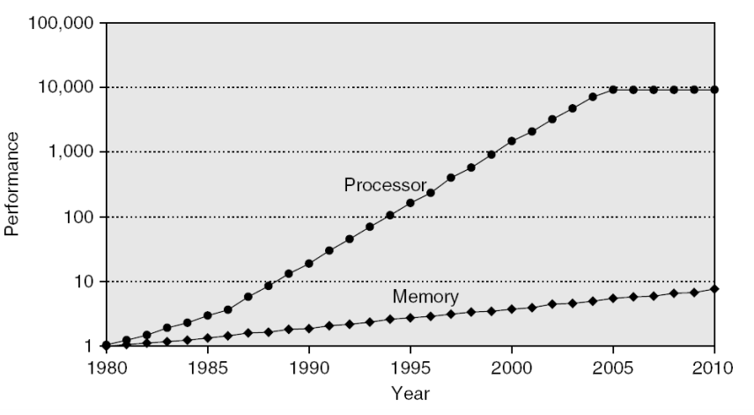
CPU vs. Memory: Performance vs Latency

Slide 9
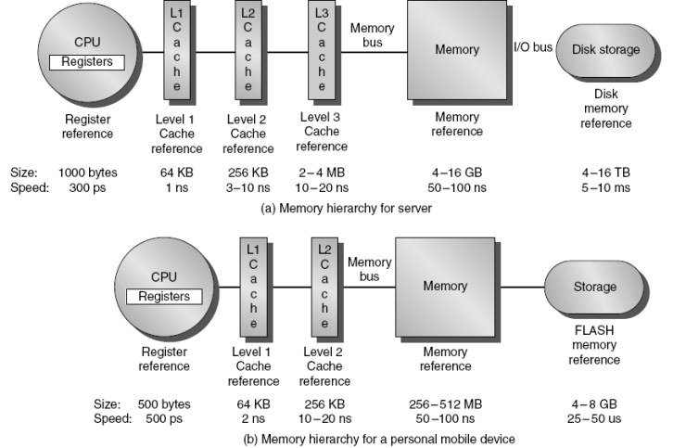
Memory Hierarchy

Slide 10
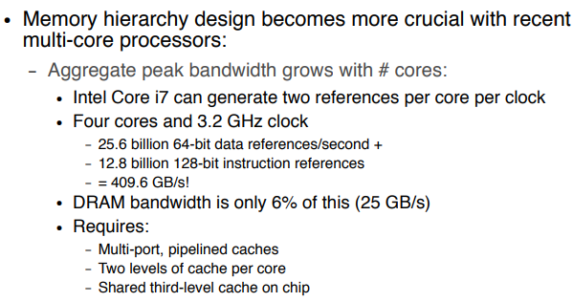
Memory Hierarchy Design Considerations

Slide 11
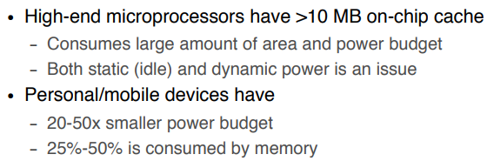
Performance and Power for Caches

Slide 12
https://youtu.be/MPBJuwzG-ss
THANKS

